Slide 1



Optimized APP-Based Vehicle Routing Protocol
Students
C . Nagendra - 99220040253
p . Deepthi – 99220041305
V . Naga Chaitanya - 99220041209
K . Vinay -99220041209
Hello
Guide
Dr. M.K. Nagarajan
Computer Science and engineering
Kalasalingam academy of research and education

Slide 2
ABSTRACT
Large education institutions tend to face navigation problems with students, faculties, and even visitors. Physical maps and signboards are commonly shown to be grossly inadequate within such dynamically growing campuses. This work proposes an Optimized App-Based Routing and Campus Navigation System that can enable the student, as well as the faculty and visitor, in finding real-time route guidance, information about their classrooms, lost-and-found tracking, events happening on campus, and feedback management. The system is developed using a cross-platform support tool called Flutter, while Google Maps API is used for routing; the backend is Firebase for storage and authentication. The routing mechanism applies graph-based pathfinding to compute optimal and shortest routes between locations on campus. Improving, in other words, accessibility or redundancy is beneficial when it comes to having better users' experience through confusion mitigation and leverage towards a smart digital ecosystem for mobility on campus.

Slide 3
INTRODUCTION
The rapid growth of large educational institutions has transformed university campuses into miniature cities that include academic buildings, administrative offices, laboratories, hostels, recreational centers, and service facilities spread across vast geographical areas. Navigating these complex environments presents significant challenges for students, faculty members, new entrants, and visitors. Traditional navigation methods such as printed maps, static signboards, and verbal guidance are time-consuming and often ineffective in dynamic campus environments. Difficulties in locating lecture halls, departmental offices, and essential service centers result in wasted time and reduced productivity. In addition, crucial campus services such as lost-and-found management, event announcements, and feedback systems typically operate in isolated platforms, leading to fragmented information and limited user engagement. To address these challenges, this research proposes the development of an Optimized App-Based Routing and Campus Navigation System that integrates multiple campus services into a unified digital platform. The system is developed using Flutter for cross-platform compatibility, Google Maps API for real-time mapping and navigation, and Firebase for secure data storage and user authentication. It incorporates graph-based routing algorithms to generate optimized paths within the campus environment. The proposed solution also supports faculty information retrieval, lost-and-found management, event announcements, and direct feedback submission, thereby enabling smarter campus interactions and contributing to the digital transformation of modern higher education institutions.

Slide 4
EXISTING SYSTEM vs PROPOSED WORK IMPLEMENTATION:
EXISTING SYSTEM:
• Uses printed maps, signboards, and manual directions • Depends on physical notice boards for announcements • Separate systems for faculty information and events • Manual lost-and-found process • Feedback collected using paper or informal methods • No real-time navigation support • No centralized digital information system • Time-consuming and inefficient processes
PROPOSED SYSTEM:
Mobile app-based campus navigation system • Real-time GPS tracking and route optimization • Centralized digital platform for all campus services • Searchable faculty directory • Automated lost-and-found system with image support • Real-time event notifications and updates • Digital feedback submission system • Secure user authentication and login • Cross-platform support using Flutter • Cloud-based data storage using Firebase

Slide 5
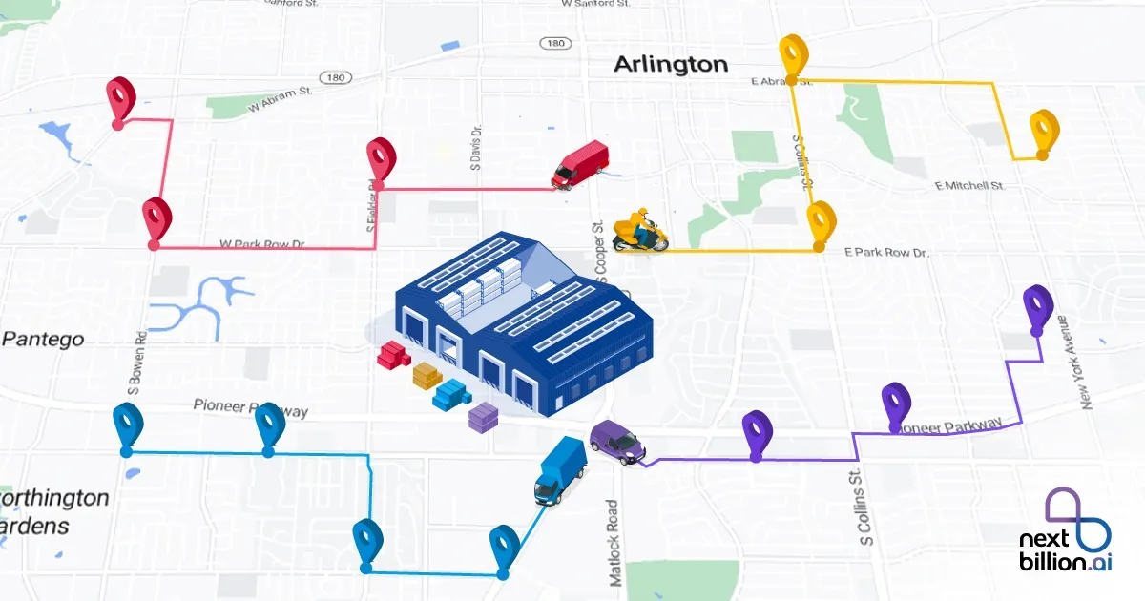
Problem Statement
Large university campuses are increasingly complex, making it difficult for students, staff, and visitors to locate buildings, departments, classrooms, and essential service centers efficiently. Existing navigation methods such as printed maps, static signboards, and manual assistance are outdated, time-consuming, and often inaccurate in real-time scenarios. Important campus services like faculty information access, event notifications, lost-and-found management, and feedback collection are typically handled through separate and disconnected systems, resulting in poor communication and limited accessibility. The absence of an integrated digital platform leads to confusion, wasted time, reduced productivity, and poor user experience. Therefore, there is a strong need for an optimized, centralized, app-based routing and information management system that can provide real-time navigation, unified access to campus services, and accurate information to improve efficiency and user satisfaction within large educational institutions.

Slide 6
Literature Survey
S.N | Title of Paper | Description | Merits | Demerits
1 | M. Sangeetha et al. | Developed a Google Maps–assisted campus navigation system with building markers. | Helps users identify block locations easily and supports GPS mapping. | Does not support optimized routing or multi-service integration.
2 | A. Prakash et al | Proposed hybrid GPS and QR-based indoor/outdoor navigation. | Improves indoor accuracy where GPS signal is weak. | Requires manual QR scanning, reducing usability.
3 | N. Fathima et al. | Created a Flutter-based smart locator system with Firebase backend. | Cross-platform compatibility and real-time data storage. | Lacks shortest path generation and dynamic routing capabilities.
4 | C. Lakshmi et al. | Implemented indoor navigation using BLE beacons. | Accurate micro-location tracking in enclosed spaces. | Expensive deployment and frequent calibration required.
5 | V. Ramakrishnan et al. | Designed GIS-based map visualization for universities. | Supports precise spatial representation of campus layouts. | Not available as a dynamic or mobile-based system.
6 | R. Bakshi et al. | Implemented shortest path algorithms (Dijkstra/A*) for campus layout routing. | Ensures precise and optimized route computation | Not integrated with live map frameworks or mobile applications.
7 | K. Srinivas et al. | Built a student-assistance mobile application for academic resources and communication. | Useful for campus information access. | No mapping or navigation component included
8 | S. Aravind et al. | Developed a multi-functional campus app with events, lost-and-found, and faculty search. | Provides multiple services under one platform. | Missing route optimization for physical navigation

Slide 7
Technologies Used
Framework: Flutter (Dart)
Maps: goggle_maps_flutter
Location: geolocator
Routing: Google Directions API + OSRM (Open Source Routing
Machine)State Management: Provider / setState
Backend: Firebase (Auth, Firestore)
t

Slide 8
PROPOSED METHODOLOGY
• Collect system requirements from students, faculty, and administrators • Define system scope and use-case scenarios • Design overall system architecture • Create database schema and data models in Firebase • Integrate Google Maps API for real-time map display • Implement graph-based routing algorithm for shortest path calculation • Develop user-friendly interface using Flutter • Build modules for faculty directory, events, lost-and-found, and feedback system • Implement secure user authentication and authorization • Perform unit testing and integration testing • Optimize application performance and security • Deploy the application for real-world usage • Monitor system functionality and gather user feedback

Slide 9
CRITICAL ANALYSIS:
The Optimized App-Based Routing and Campus Navigation System is a useful solution that helps students, staff, and visitors easily find locations and access important campus services through a single mobile application. It improves convenience by providing real-time navigation and quick access to information such as faculty details, events, lost-and-found items, and feedback options. The app works smoothly across devices and saves time for users. However, it depends on a stable internet connection and accurate GPS signals, which may not work well indoors or in areas with weak network coverage. There are also minor concerns about user privacy when using location services. Even with these limitations, the system is effective, practical, and has strong potential for future improvements like offline navigation and indoor location tracking.

Slide 10
PROPOSED SOLUTION
To overcome the challenges of navigation and information accessibility in large university campuses, this project proposes the development of an Optimized App-Based Campus Navigation and Service Management System. The solution is designed as a centralized mobile application that integrates real-time GPS-based routing with essential campus services. The system uses Flutter to provide a smooth and consistent user interface across multiple platforms and utilizes Google Maps API to display accurate maps and provide real-time route guidance. Firebase is used as a secure backend for user authentication, real-time database management, and cloud storage. The application includes key modules such as campus navigation, faculty directory, event notifications, lost-and-found management, and feedback submission. A graph-based routing algorithm ensures that users receive the shortest and most efficient paths between campus locations. This proposed solution improves operational efficiency, reduces time spent locating services, enhances communication, and significantly improves the overall campus experience.

Slide 11
OBJECTIVES
• To design and develop an intelligent campus navigation system using real-time GPS technology. • To optimize routing paths using graph-based shortest path algorithms for better accuracy. • To provide an interactive and user-friendly interface for easy navigation and service access. • To integrate a digital faculty directory with search and filter capabilities. • To develop a real-time event notification and campus announcement system. • To implement a lost-and-found management module with image upload and status tracking. • To enable secure user registration and login with data protection mechanisms. • To store and manage application data safely using cloud-based backend services. • To reduce dependency on physical notice boards and manual information systems. • To support real-time updates of campus information and services. • To enhance user engagement through feedback and query submission features. • To ensure system scalability to support a large number of users simultaneously. • To provide offline access to basic campus maps wherever possible. • To improve accessibility for new students and visitors unfamiliar with the campus. • To contribute to the development of smart campus digital infrastructure

Slide 12
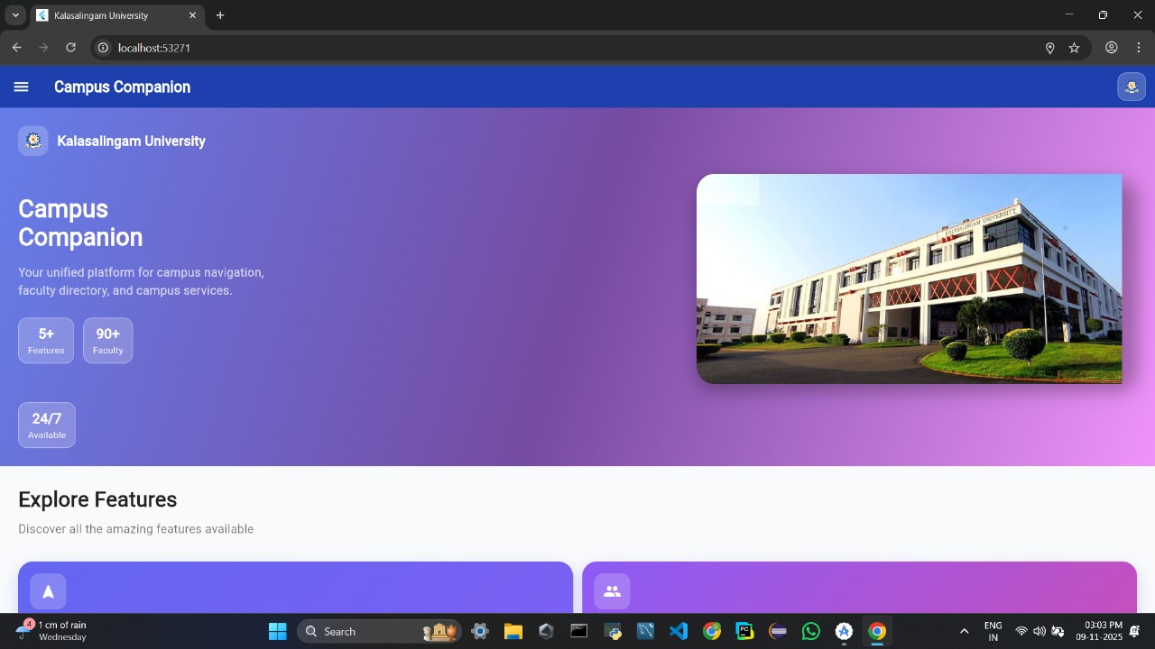
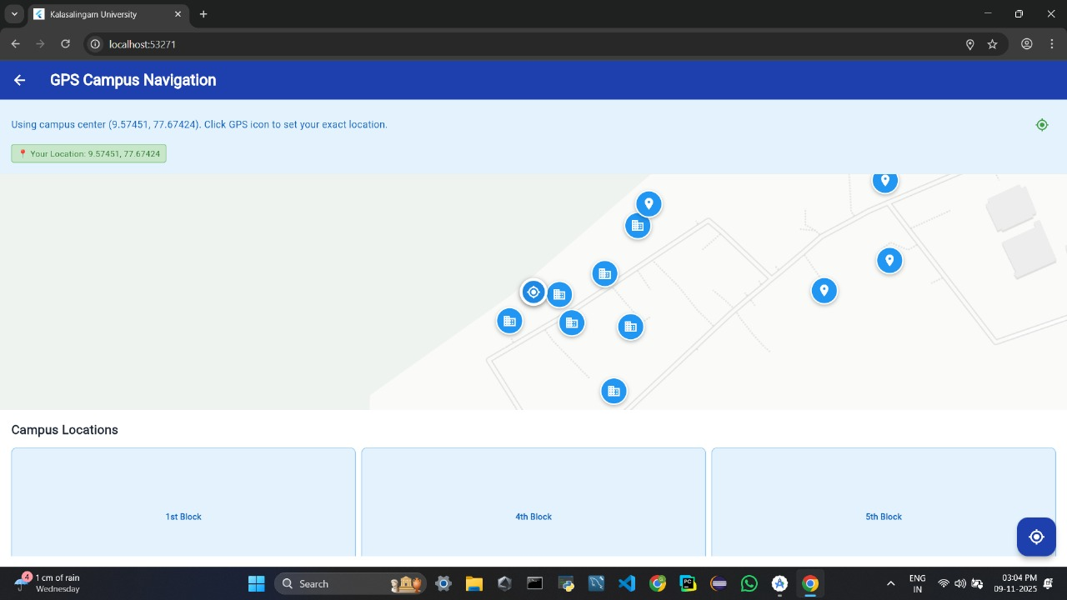

Slide 13
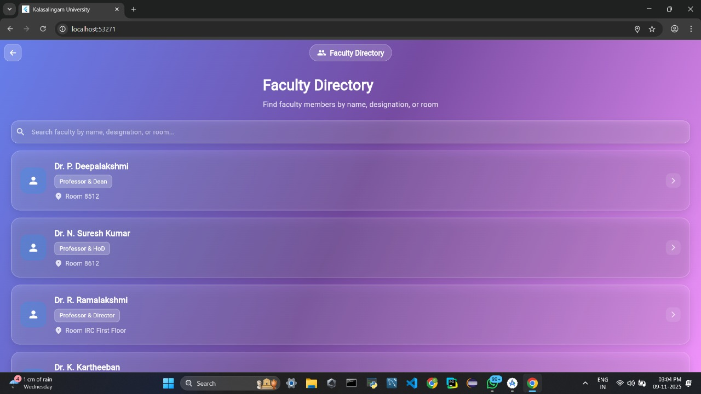
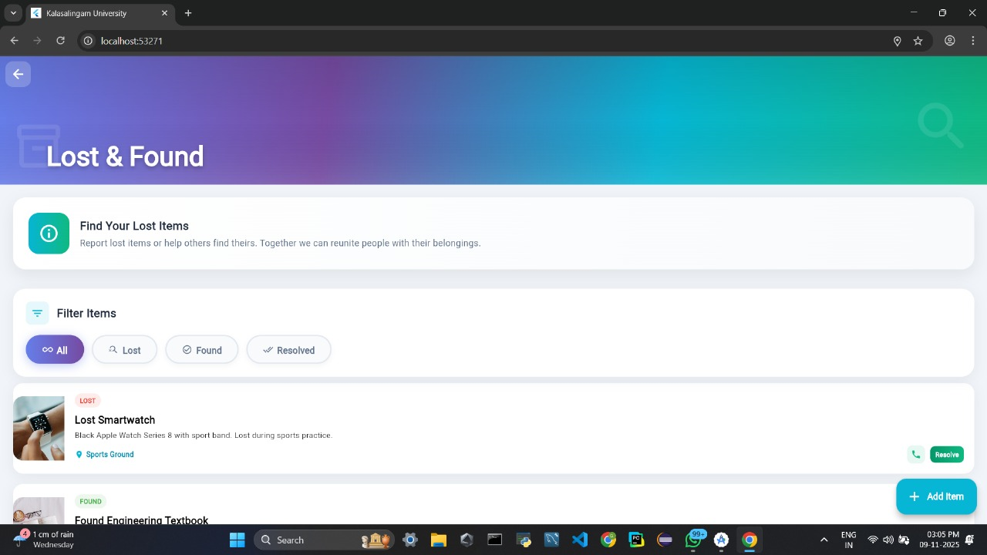

Slide 14
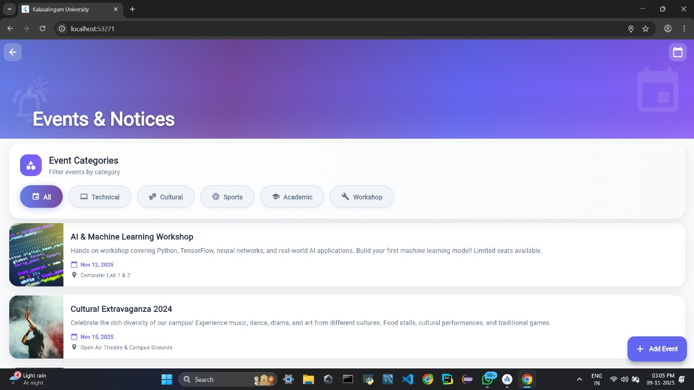
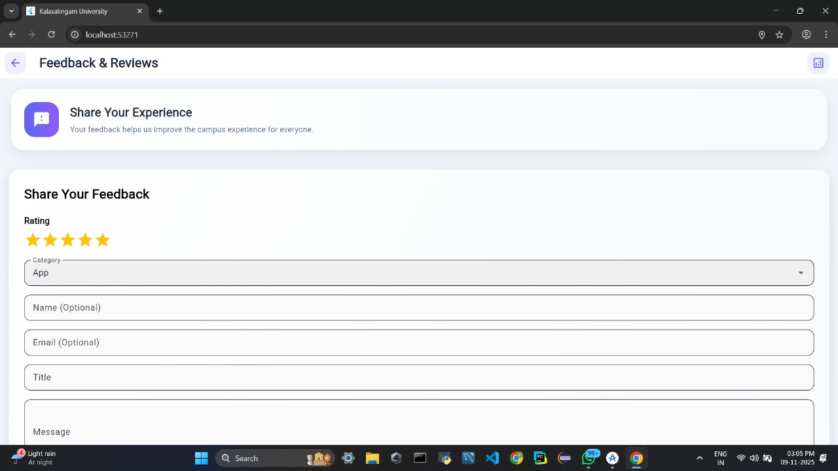

Slide 15
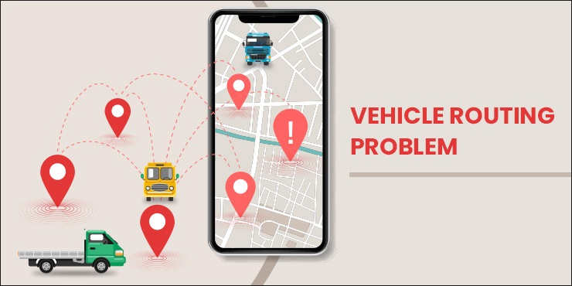
Conclusion
The Optimized App-Based Campus Navigation and Service Management System successfully provides a smart and efficient solution for the challenges faced in large educational campuses. By integrating real-time GPS navigation, faculty information, event management, lost-and-found services, and feedback systems into one application, the project improves accessibility, saves time, and enhances overall user experience. The use of modern technologies such as Flutter, Google Maps API, and Firebase ensures smooth performance, secure data handling, and cross-platform compatibility. The system reduces confusion, improves communication between users and administrators, and minimizes dependence on traditional manual processes. Overall, this project demonstrates the effectiveness of digital transformation in campus environments and serves as a strong foundation for future smart campus applications.

Slide 16
References
[1] Y. D. Choudhari, A. H. Choudhari, R. P. Raut, J. C. Raut & S. D. Ramteke, “Campus Compass Android App,” IJRASET: International Journal for Research in Applied Science & Engineering Technology, 2024.
[2] N. Nordin, M. A. Markom, F. A. Suhaimi & S. Ishak, “A Web-Based Campus Navigation System with Mobile Augmented Reality Intervention,” Journal of Physics: Conference Series, 1997(1), 2021.
[3] M. Lakshmi K., R. Manojkumar, R. Kesavan & S. Arul Kumaran, “Campus Route Map,” International Research Journal on Advanced Engineering Hub (IRJAEH), vol. 3,
[4] Chinmayi M., Ifra Simran K.S, Nischitha H S & Dr. D. V. Rajeshwari Devi — “Campus Navigator with Speech Assistance,” International Journal of Engineering Research & Technology
[5] “Smart Campus Navigation: An IoT-Based Approach for Intelligent Administration,”
[6] “Smart Campus Navigation System,” IJCRT 2023 (authors: Amisha P. Naik, Nese Likhita, Anupama Sharma, Richa Tripathi), Smart-campus model combining mobile application and IoT for campus management and location guidance.
[7] Mohith Prajwal, Nesar, Aishwarya, Soumya B.S — “Campus Navigation Using Augmented Reality,” 2020.
[8] “Android App for College Navigation Using UWB,” IRJET, 2019.
[9] “Campus Navigation on Android Platform,” IJSTE, 2014.
[10] Bereket Haile — “Enhancing Campus Navigation with Mobile Applications,” 2023 thesis describing a mobile campus map app with location tracking and route direction.
[11] Stéphanie Jean-Daubias, Thierry Excoffier, Otman Azziz — “Routes to a Building or a Room Suited to the Specific Needs of Users,” 2024, describing a multi-service campus app combining resource discovery and internal orientation support.
[12] Chia Hsuan Tsai, Fatemeh Elyasi, Peng Ren, Roberto Manduchi — “All the Way There and Back: Inertial-Based, Phone-in-Pocket Indoor Wayfinding and Backtracking Apps for Blind Travelers,” 2024, a study demonstrating sensor-based indoor navigation without external infrastructure.
[

Slide 17


